Slide 1
Final Project: Child Mortality
Grpup-01
Adam Gersowitz, Christopher Bloome, David Blumenstiel, Forhad akbar, Jeyaraman Ramalingam,Kevin Potter

Slide 2
Overview
Background and motivation
Explore if the improvement in quality of community resources, in particular the access to improved water and access to improved sanitation, will impact child mortality rates in a country.
Examining whether access to “at least basic services” for both sanitation conditions and water access will impact child mortality rates
Additionally, we will use a categorical grouping variable for the type of economic region the country is a part of ranging from 1, (Developed Region - G7) to 7, (Least Developed Region).
These metrics were used to predict the probability of an individual dying between ages 1 and 5.

Slide 3
Data
From SEDAC
2106 rows
6 variables
Require pre-processing

Slide 4
Data pre-processing
The data was obtained as a Microsoft Excel file; it was then converted to a .csv file.
The data was converted from wide to long format
Missing data was imputed

Slide 5
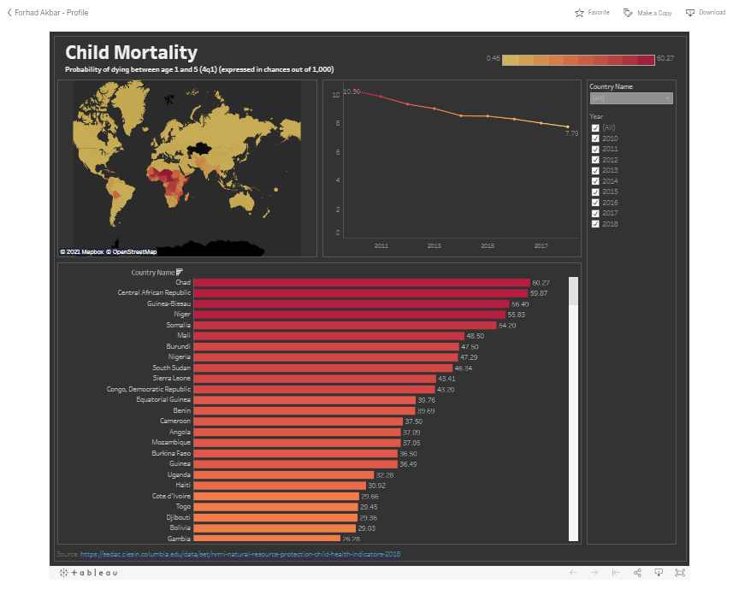
Interactive Tableau Dashboard: https://public.tableau.com/views/ChildMortality_16211276461000/ChildMortality?:language=en&:display_count=y&:origin=viz_share_link
Exploratory Data Analysis

Slide 6
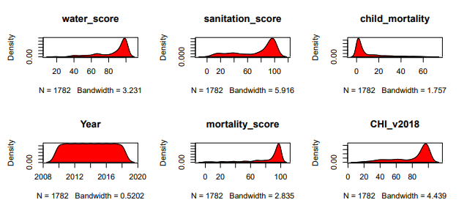
Exploratory Data Analysis

Slide 7
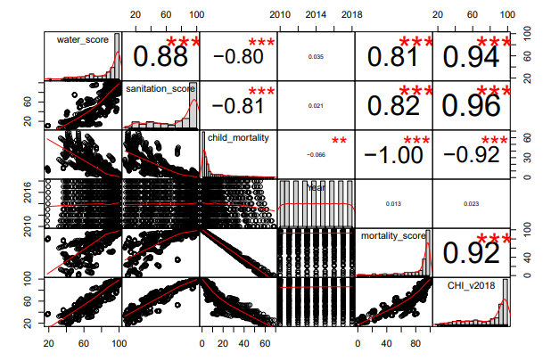
Correlation

Slide 8
Models Built
Models
Model 1: Liner regression with water-score and sanitation-score as independent variables
Model 2: ridge regression with water-score and sanitation-score as independent variables
Model 3: Liner regression with water-score, sanitation-score and economy as independent variables
Model 4: Elastic-net regression with water-score, sanitation-score and economy as independent variables

Slide 9
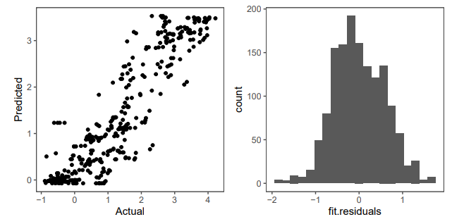
Models Built
Model 1: Liner regression with water-score and sanitation-score as independent variables
Key factors:
The model achieved an r-squared value of 0.826, and when predictions were performed on the holdout set, the predictions fit the actual values with an r-squared of 0.821.
Overall, the model meets the assumptions of linear regression
It accurately predicts fewer deaths with higher water-score and sanitation-score, indicating that these variables are impactful towards child mortality

Slide 10
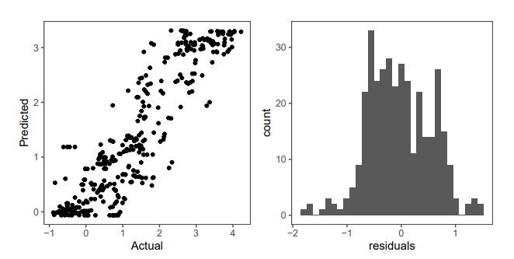
Models Built
Model 2: ridge regression with water-score and sanitation-score as independent variables
Key factors:
The model achieved a fit of 0.824, and a validation fit of 0.822 , indicating a good fit without overfitting
One interesting finding is that this model weighed water-score more than sanitation-score; the coefficient for water-score was about 1.29 times higher than for sanitation-score.
This could indicate that access to “improved water sources” nearby one’s dwelling might be more important for reducing child mortality than sanitation

Slide 11
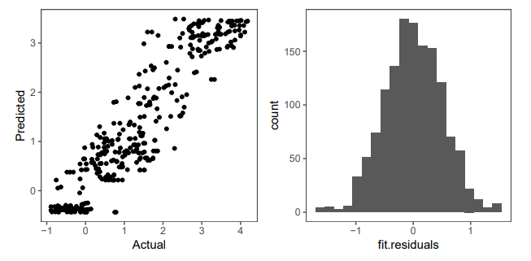
Models Built
Model 3: Liner regression with water-score, sanitation-score and economy as independent variables
Key factors:
This model achieved an r-squared value of 0.869, and a validation r-squared of 0.851, indicating some but very little overfitting, and a high overall fit
This model expects more child mortality for the least developed
Residuals are normally distributed, with slight heteroscedasticity

Slide 12
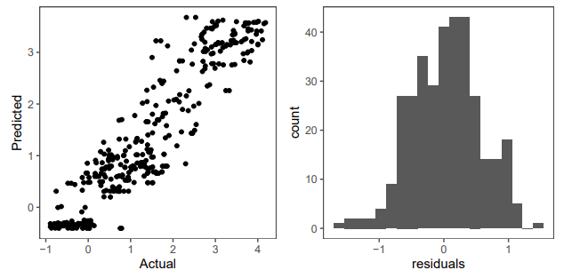
Models Built
Model 4: Elastic-net regression with water-score, sanitation-score and economy as independent variables
Key factors:
This model has an r-squared of 0.871, with a validation r-squared of 0.855; a very good fit with a little overfitting.
Residuals are mostly normally distributed, with slight heteroscedasticity.
It finds similar trends in the coefficients to model 3 for the economic data.

Slide 13
Model Selection
Key factors:
In addition, the individual relationships water and sanitation scores have to child mortality were examined.
It was determined via linear regression that both water and sanitation scores can individually explain approximately 78% of the variation in child mortality after variable transformation.
Overall, access to improved water and sanitation can explain most of the excess child mortality within a country, with the best valid model used here (model 4) able to predict transformed responses with a fit of 0.855 (r-squared) on a holdout set
All models did something well
Best Model 4: Elastic-net regression

Slide 14
Conclusion
A model can predict with some accuracy child mortality within a country
Overall, access to improved water and sanitation can explain most of the excess child mortality within a country, with the best valid model used here (model 4) able to predict transformed responses with a fit of 0.855 (r-squared) on a holdout set

